Slide 1
Creating simple web application

Slide 2
Before we start
There are many possible ways to make web applications
We have these types:
Static Web Applications.
Dynamic Web Application.
Single Page Apps (SPA)
Multi-Page Apps (MPA)
Portal Web App.
Animated Web Applications.
Web Applications with a Content Management System
Most of them will have:
Backend (business logic and data)
Frontend (presentation and user experience)

Slide 3
What is what
Static Web Applications – any web application that can be delivered directly to an end user's browser without any server-side alteration of the HTML, CSS, or JavaScript content.
Dynamic Web Application - dynamic web application generates the pages/data in real time, as per the request, a respective response will trigger from the server end and will reach the client end(your computer)
Single Page Apps (SPA) – all that you need from the application is on one page, content changes but you stay on the same page
Multi-Page Apps (MPA) – typical website with a lot of functionalities scattered on the many pages, where accessing different data requires going to different page

Slide 4
Now how to make those
We can use different techniques and architecture.
For the sake of simplicity, we will stay focused on these:
Web Application using MVC
Web API

Slide 5
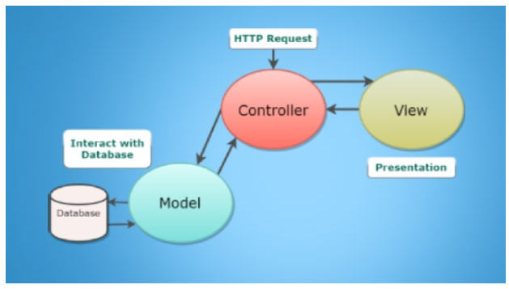
What is MVC
MVC = Model View Controller
See next slide more details
Model – responsible for data
Controller – responsible for logic of the application
View – responsible for what user of the application see

Slide 6
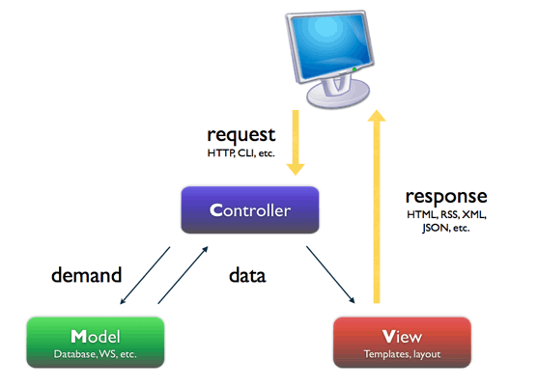
How does MVC work?
MVC = Model View Controller
User from computer sends http request
Controller is picking up the request
Controller contacts database using →
Model knows how to ask DB for data, how to do CRUD
Controller gets data from DB using Model
Controller finishes it’s work by preparing View
View is sent to user by response

Slide 7
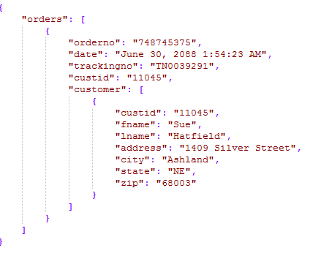
Web API
Web Api is similar to general Web app, with just one difference:
IT DOESN’T HAVE FRONTEND
Actually it’s frontend is the result in JSON:

Slide 8
Why do we use API’s and not web apps
Nowadays systems have become very complex and someone came up with great idea:
How about we use a lot of small programs where each one of them will do one thing – return data
Then, how about we make one smart program which will control everything by telling smaller programs what to do
Now maybe some other program can use that data to show it to the user?
From APIs we got Micro-service Architecture

Slide 9
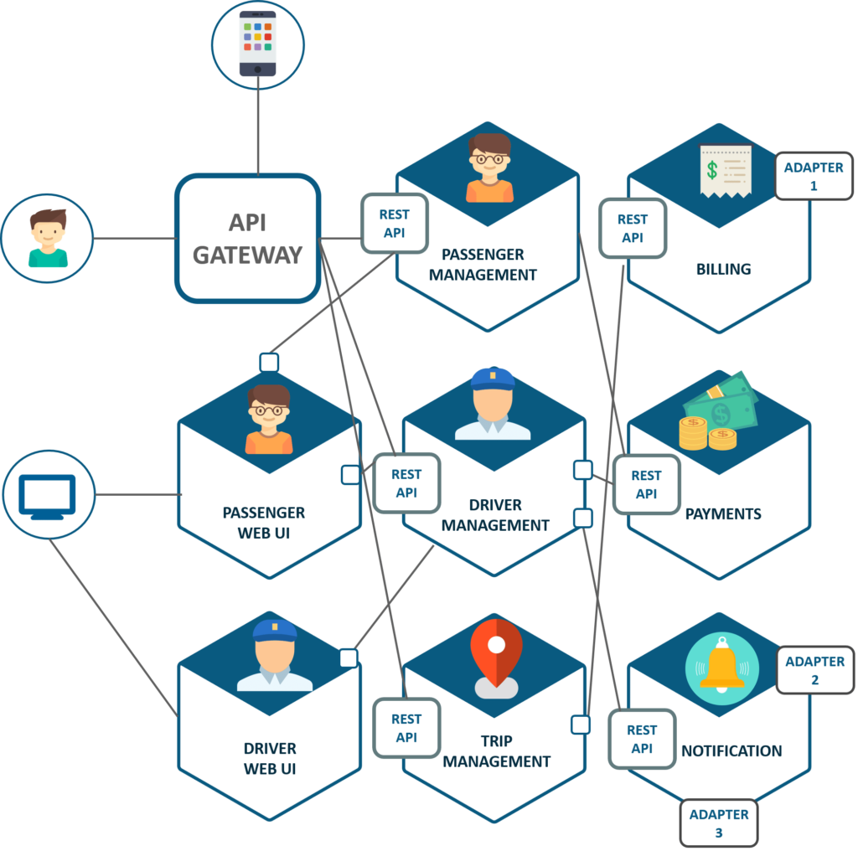
API in Microservice Architecture

Slide 10
So how can we use Web API
We will make a Web API that will show some JSON
Then we will create static website that will fetch URL of WEB API
We will do something with the obtained JSON data:
Either to create HTML elements or to show it in the console

Slide 11
Let’s see these applications
Let’s open Visual Studio and create new projects:
Web Application .Net Framework – MVC
Web Application .Net Framework – Web API
At this moment we will not use .Net Core (newer version) since we will make very basic programs.
Note: to fix the CORS issue, see the next page

Slide 12
In case API is making trouble with CORS
You need to go to Web.config, find <configuration> and add the following lines if missing:
<configuration>
<system.webServer>
<httpProtocol>
<customHeaders>
<add name="Access-Control-Allow-Origin" value="*" />
</customHeaders>
</httpProtocol>
</system.webServer>
</configuration>

